Slide 1

Spectrum News Case Analysis (July-17 Morning Show )
Jack Driscoll

Slide 2
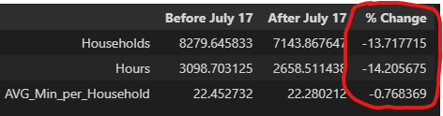
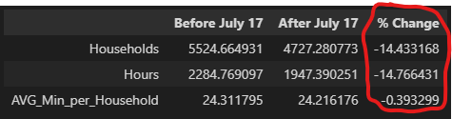
Morning Show Descriptive Statistics:
An initial analysis of the weeks before and after the launch of the new morning show conveyed a loss of viewers in the weeks after the show launched.
However, in considering a similar loss of viewers for competing networks, it is likely that other factors, including time of year and data reporting issues contributed to this perceived difference.
Spectrum Viewership:
Average Daily Hours Total: 11008
Average Number of Households Watching: 7388
Average Number of People Reached (day): 19578
Penetration from Subscriber Base: 2.96 %
Other Networks Averaged:

Slide 3
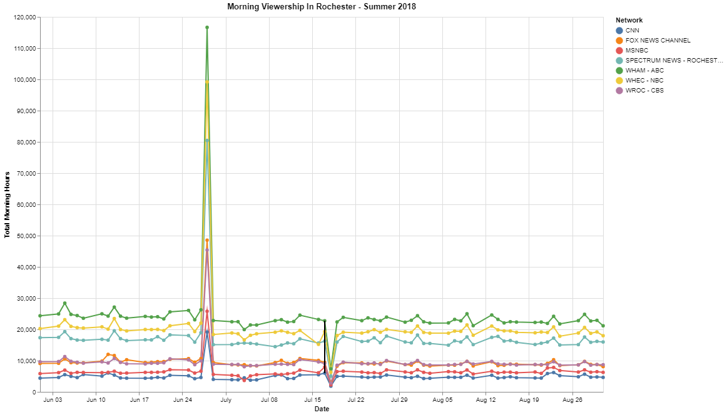
The Big Picture (Total Viewership for Each Network by Day)
New Morning Show Launch Date
Notes:
Total viewership by day, for each network.
We see clear outliers on 06-28 and 07-18 – maybe data reporting issues with the hardware? Or maybe just extremely unique days

Slide 4
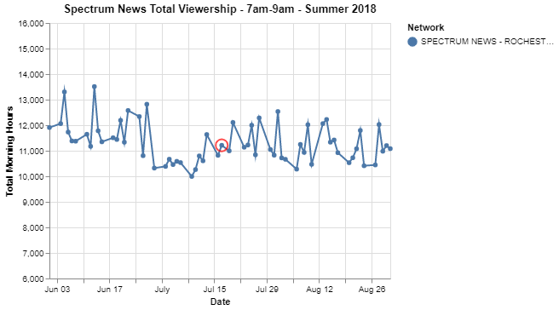
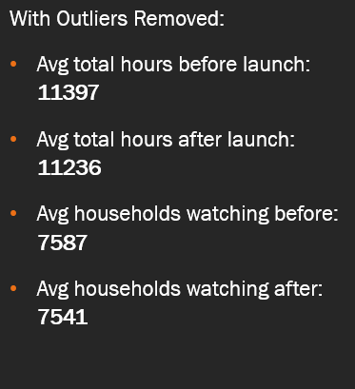
Isolating Spectrum in the Morning
(Total Viewership for Spectrum News 7am- 9am only, Outliers Removed 06-28, 07-18)
Launch Date
Notes:
After removing outliers and isolating spectrum;
We see little to no impact on viewership. A t-test between the two groups results in a p-value of 0.4, meaning there is a 40% probability this tiny difference is due to chance alone.

Slide 5
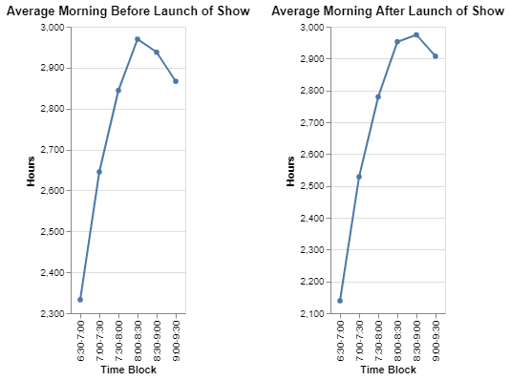
Impact on Viewership Patterns and Overall Conclusions
After removing outliers, we see extremely similar patterns in morning viewership in the periods before and after the launch.
It is likely that the new morning show has had little to no impact on morning viewership so far.
This is a preliminary conclusion; it is still very early in the life of the show, and I am working with time-limited data.
Further analysis could be performed given more time and more data.

